Slide 1
Cqu lab equipment management system
Final presentation ( Week 1 to week 11)

Slide 2
Team members
S.NO | NAME OF THE STUDENT | STUDENT ID
01 | ADARSHA MANI LAMICHHANE | 12140071
02 | BANDANA KAPALI | 12127043
03 | JAVAGAL SRINATH NARAYANAN | 12131213
04 | MARUF SIDDIQUE | 12132167

Slide 3
introduction
CQU lab management system is an application designed to help students and staffs easily find the lab equipment available in their respective campuses. It is made on a foundation of features that will allow it to manage the various aspects of a lab operation.
The main goal of this system is to eliminate the usage of spreadsheet to record the details of the lab equipment which we believe that will save a lot of time and effort.

Slide 4
Scope of our project
The scope of the project is the develop the application for CQU laboratory to perform multiple tasks. It will be useful for the students who can search, book, and return equipment and carried out by admin and student users
The admin users have access to create, view, delete information. In terms of student users, they can access to view equipment details and book equipment if they required.

Slide 5
Functional and non – functional requirement
The functional requirement as the behaviour of the system-how it reacts to inputs and the services it should provide,
The system will allow the admin users to create new access to the students by registering his / her details in student registration form.
The system will allow admin users to add, delete, search edit and view equipment and campus related details.
The system will allow students to view, search and book equipment by using his/her login credentials.
The system will show the history, due date and return equipment once the student users logged into the application.

Slide 6
Functional and non functional requirements
The non – functional requirements for CQU lab management system,
Security
Performance
Data storage
Usability

Slide 7
Feasibility study
The feasibility study is classified into five different types,
1. Technical feasibility
2. Economic feasibility
3. Social Feasibility
4. Legal feasibility
5. Operational feasibility

Slide 8
TECHNICAL FEASIBILITY STUDY
Technical feasibility is the process of validating the technology assumptions, architecture, and design of a product (Spacey, 2017). The main objective of technical feasibility study is to understand the project technical team who have required knowledge in NetBeans IDE, Java programming skills, Scene builder, SQL management.
The project manager or lead must find the resources who have necessary knowledge in those area. At the same time, it is important to focus on system requirements like, necessary software, tools, CPU with required configurations to have a capability to convert ideas to the working module. (Simplilearn 2021)

Slide 9
ECONOMIC FEASIBILITY STUDY
The main objective of economic feasibility study is to focus on cost – benefit analysis. It could be the decision maker whether the organisation must take this project or not. In organisation point of view, it is necessary to analyse the profitability rate of the product.
We are using cost – benefit analysis report to find the break even for this project. If the product doesn’t even cover up with fixed cost, there is no use of taking up this project (Simplilearn 2021)

Slide 10
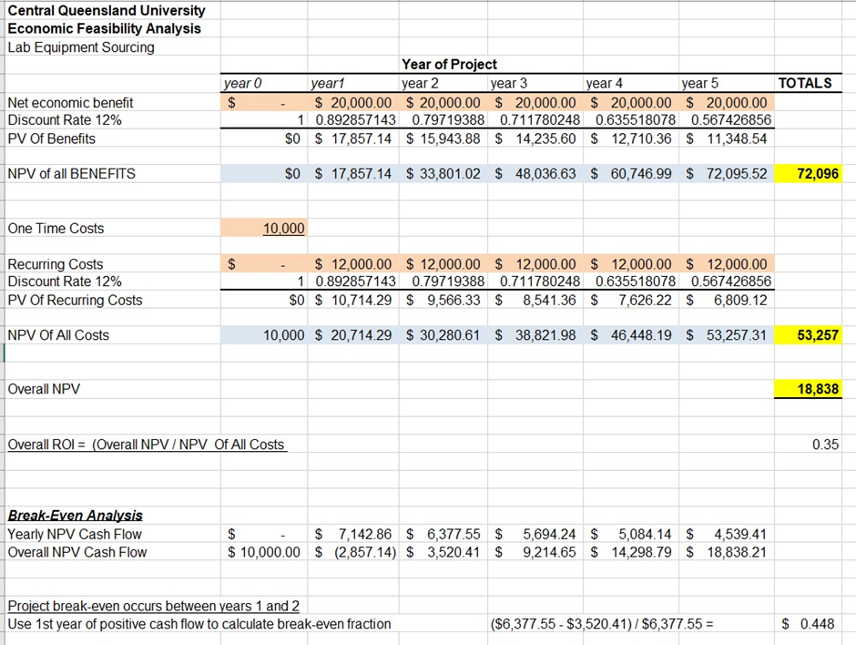
COST – BENEFIT ANALYSIS
In this cost – benefit analysis report, we have break even in the year of three. It could be beneficiary for our organisation if we take up this project. (Simplilearn, 2021)

Slide 11
SOCIAL FEASIBILITY STUDY
Computerization brings fear of unemployment among the existing staff however the system will not create any unemployment problems in the university but will create new job positions like system manager, data entry staff, operators, programmers etc.
The existing organizational structure will remain still. Also, at the time of implementing the application, training programs will be arranged for all the existing staffs of the laboratory for 5 to 7 days.

Slide 12
LEGAL FEASIBILITY STUDY
In our project (CQU lab management system), it doesn’t conflict with any other legal acts. The data about the lab is completely secured, and it will be managed with high level security measures which we mentioned in non – functional requirements. As per the legal feasibility study, it is good to go with our proposed project. (Simplilearn, 2021)

Slide 13
OPERATIONAL FEASIBILITY STUDY
Operation feasibility is the feasibility of deploying, managing, and operating the project including consideration of operational risks such as downtime (Spacey, 2017). It helps to identify the deviations from the scope of the product. It could be easy to resolve the problem arises during the development of the product.
And it also used to check whether it satisfies the requirements which the project team collected from our client (CQU University). (Simplilearn, 2021)
For our project, we are using Agile methodology with multiple sprints to analyse and monitor performance of the project team

Slide 14
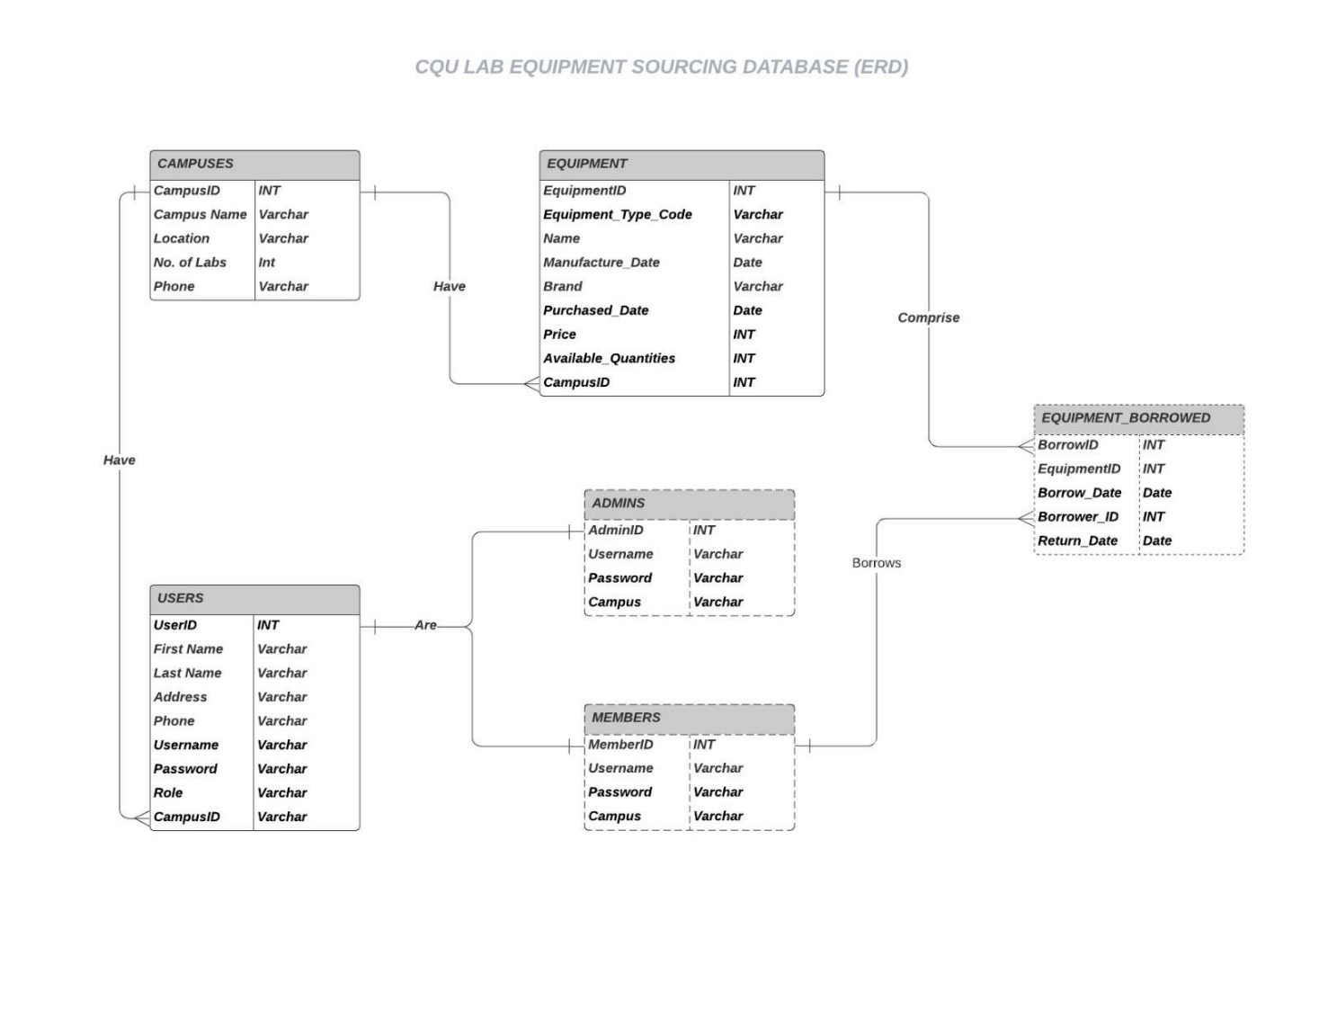
DATABASE DESIGN
The main objective of database design is to produce logical and physical design models of the database system. The database design will then decide how and what data must be stored in the system.

Slide 15
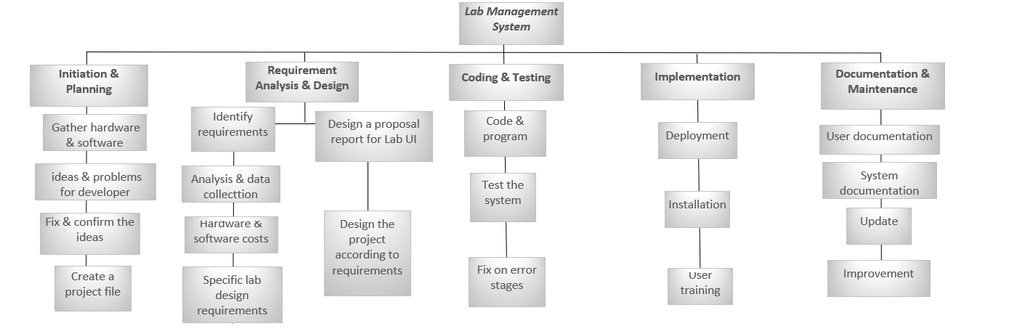
WORK BREAK DOWN STRUCTURE - WBS
Work Breakdown Structure is “a deliverable-oriented hierarchical decomposition of the work to be executed by the project team to accomplish the project objectives and create required deliverables” (cohen,2018)

Slide 16
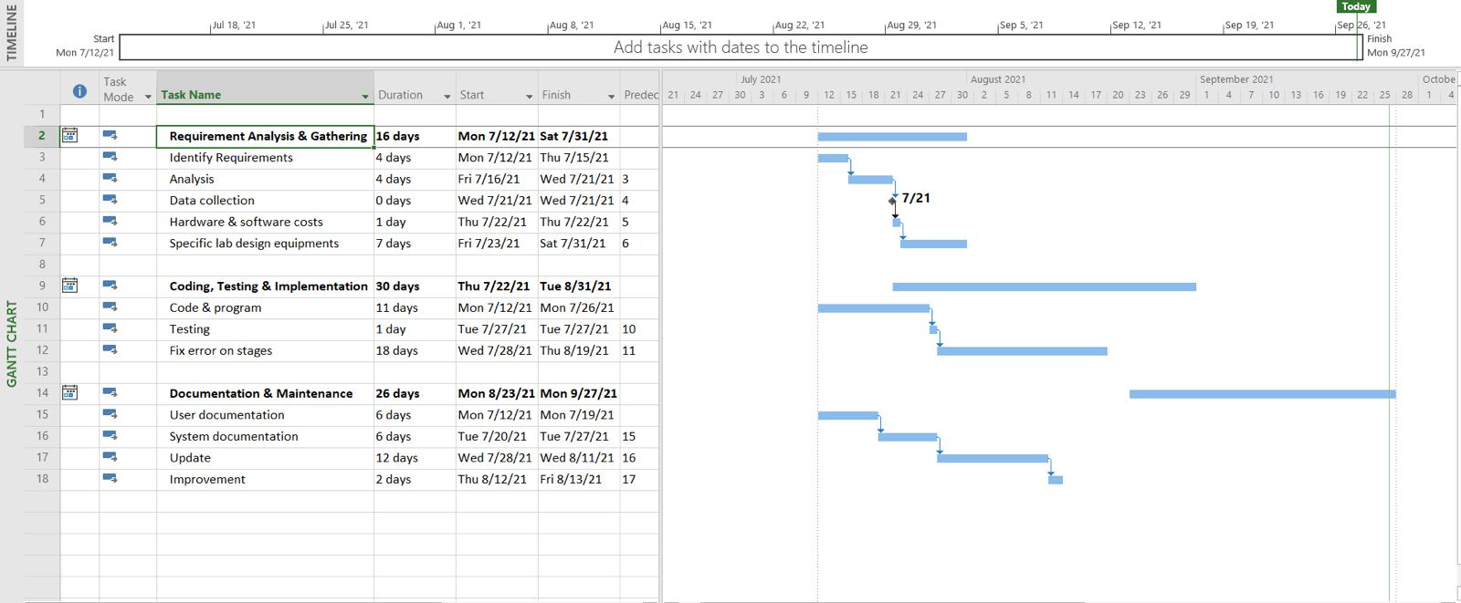
GANTT CHART
The project starts on 12th July with the requirement analysis and gathering part which took around 16 days to finish up on 31st July.
Then comes the coding, testing & implementation phase where the subtasks were divided into programming, testing, error fixing. We can see this phase took approximately 1 month
Finally comes the documentation & maintenance stage with a duration of around 29 days starting from 18th August & ending on 27th September with the subtasks that includes user & system documentation, updates & improvement

Slide 17
User stories for admin and student
As an admin
I can login into the system
I can add new student details, delete, edit and view
I can add equipment details (Name, ID, Location), delete, edit and view
I can add/Delete campus details
I can track the student history
I can see student details individually
I can logout of the system

Slide 18
User stories for admin and student
As a student
I can login into the system
I can view, search, and book the equipment in the laboratory
I can view the history of equipment which I borrowed from the laboratory
I can see the due date of the equipment which I borrowed from the laboratory
I have an option to withdraw my equipment before the due date
I can logout of the system

Slide 19
QUALITY AND RISK MANAGEMENT PLANS
List of risks involved in this project
Requirement changes frequently by client side
Data Integration
Communication problem between team members
Task need to be spitted equally
Data tracking
Lack of Expertise
Upgrade platform
Team coordination
Inventory maintenance

Slide 20
Quality metrices
List of Quality metrices involved in this project,
User Friendly
Cost of maintenance
Implication of the new technology
Functionality
GUI
Performance

Slide 21
Uml diagrams

Slide 22
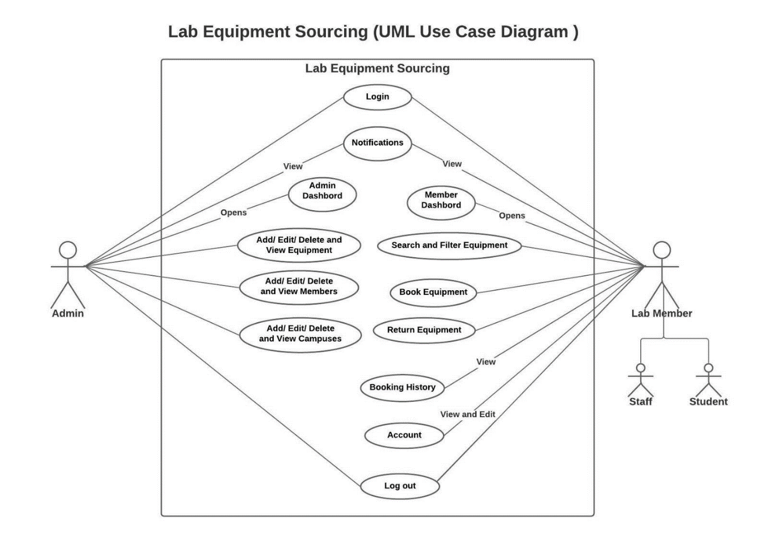
Use case diagram

Slide 23
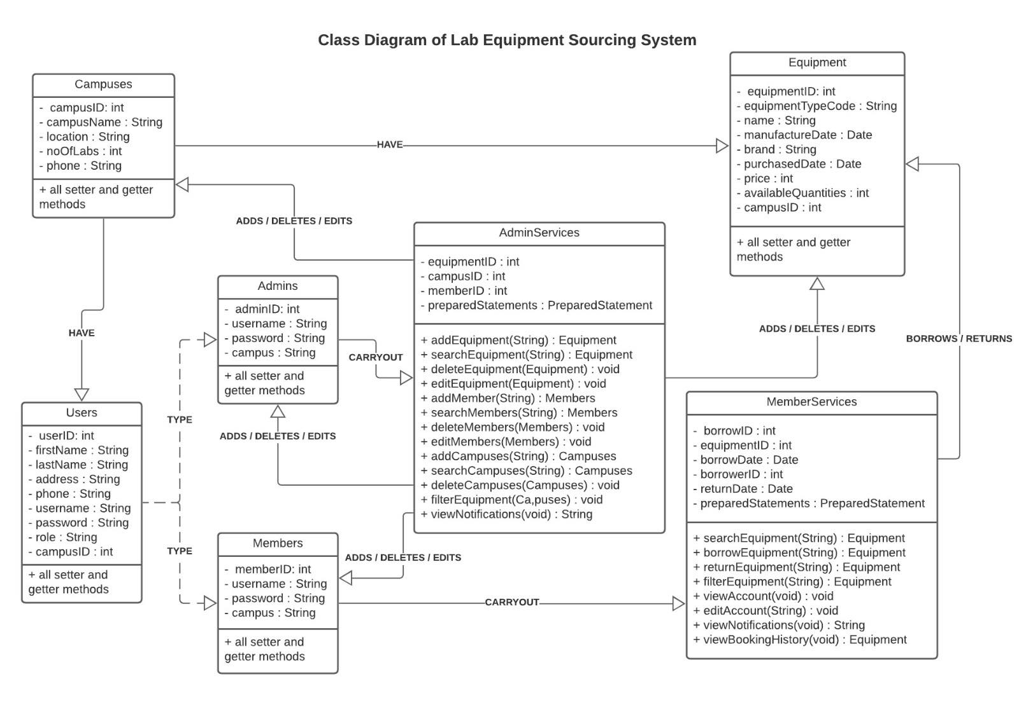
Class diagram

Slide 24
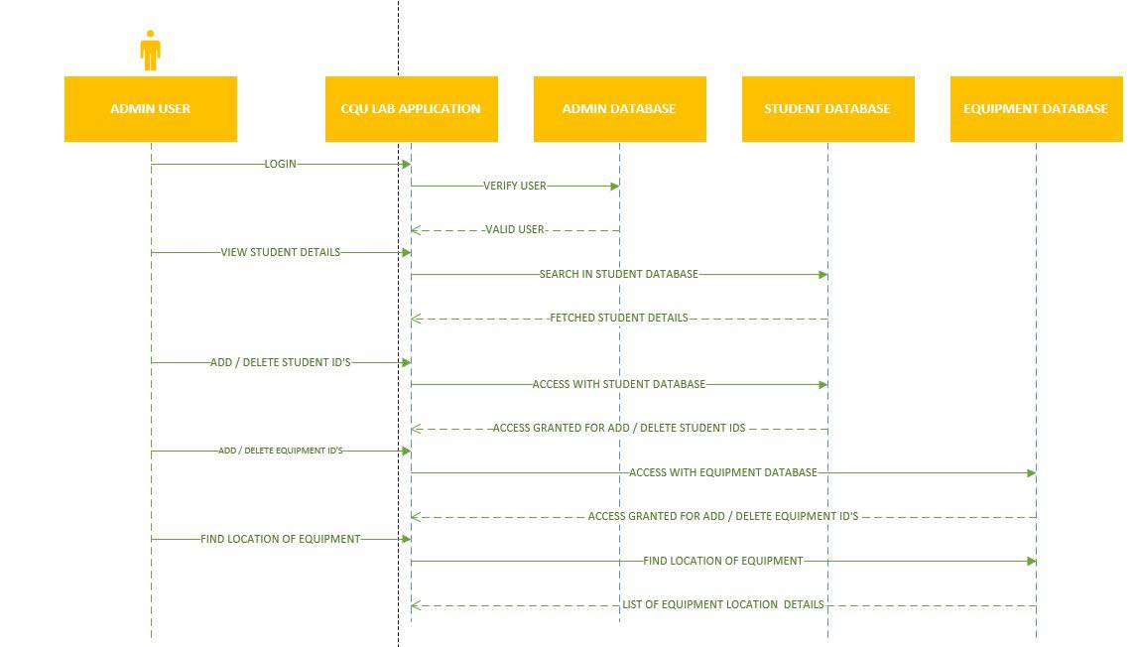
Sequence diagram – admin users

Slide 25
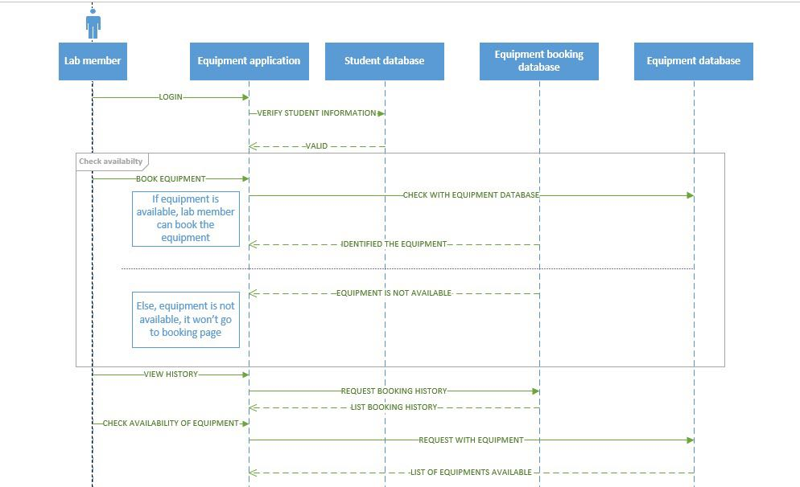
Sequence diagram – student users

Slide 26
USER INTERFACE DESIGNS - samples

Slide 27
UI DESIGNS - UPDATED
Login user – admin and student dashboard
Admin dashboard
Student dashboard
Add new student – Admin users
View student details – Admin users
Add new equipment – Admin users
View equipment details – Admin users
Add new campus – Admin users
View campus details – Admin users
Add new Admin users – Admin users
Equipment view, search and booking – Student users
View History – Student users
Due date - Notifications

Slide 28
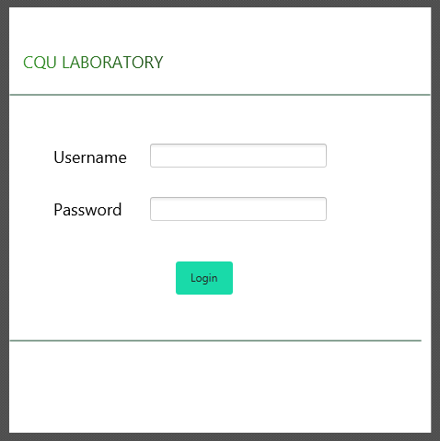
Login screen

Slide 29
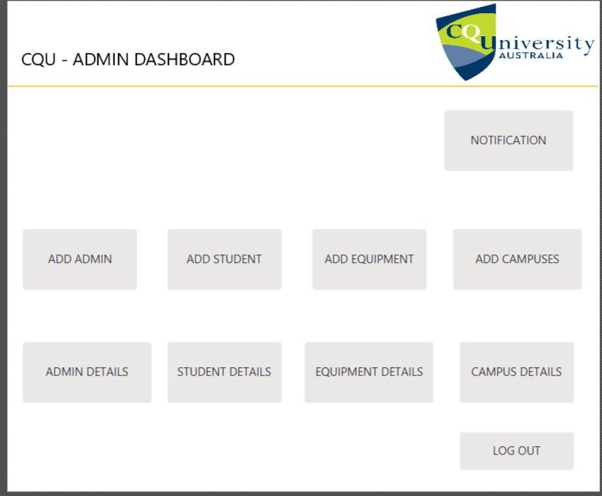
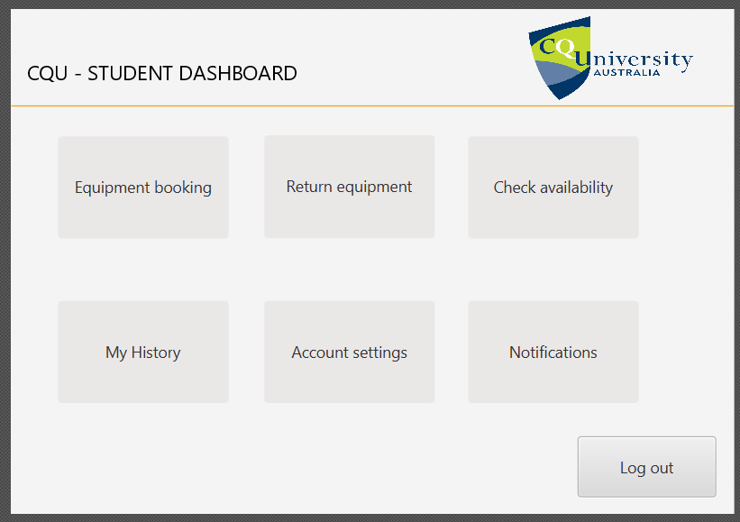
Dashboard for admin and student users

Slide 30
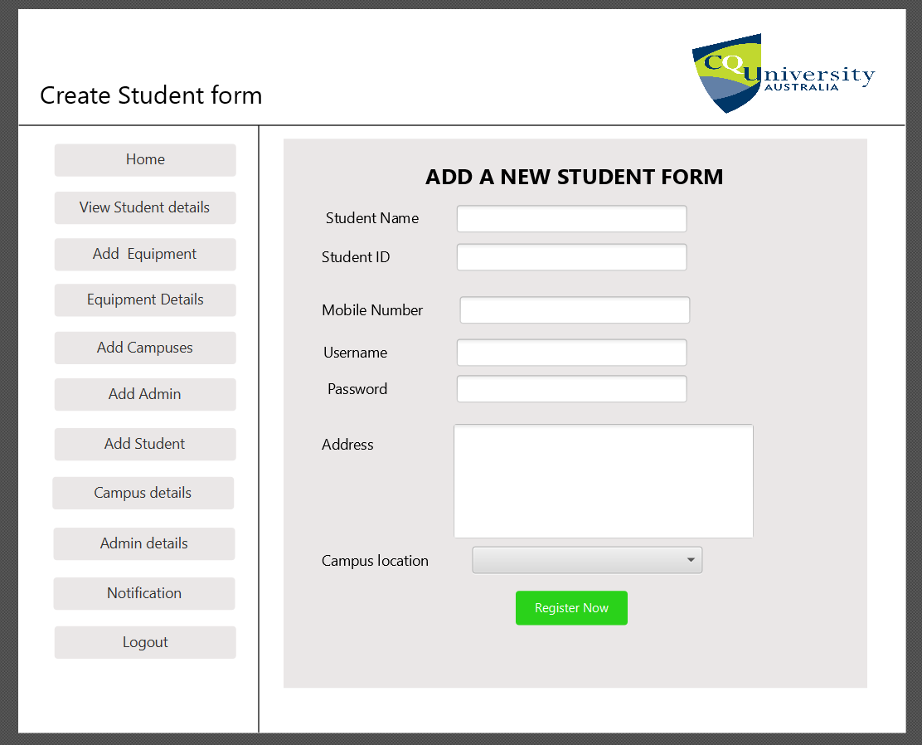
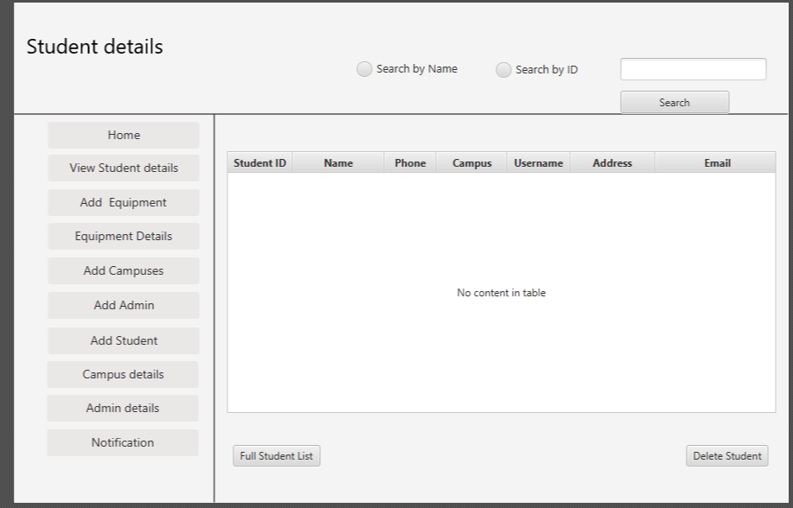
Add, Delete, view student details

Slide 31
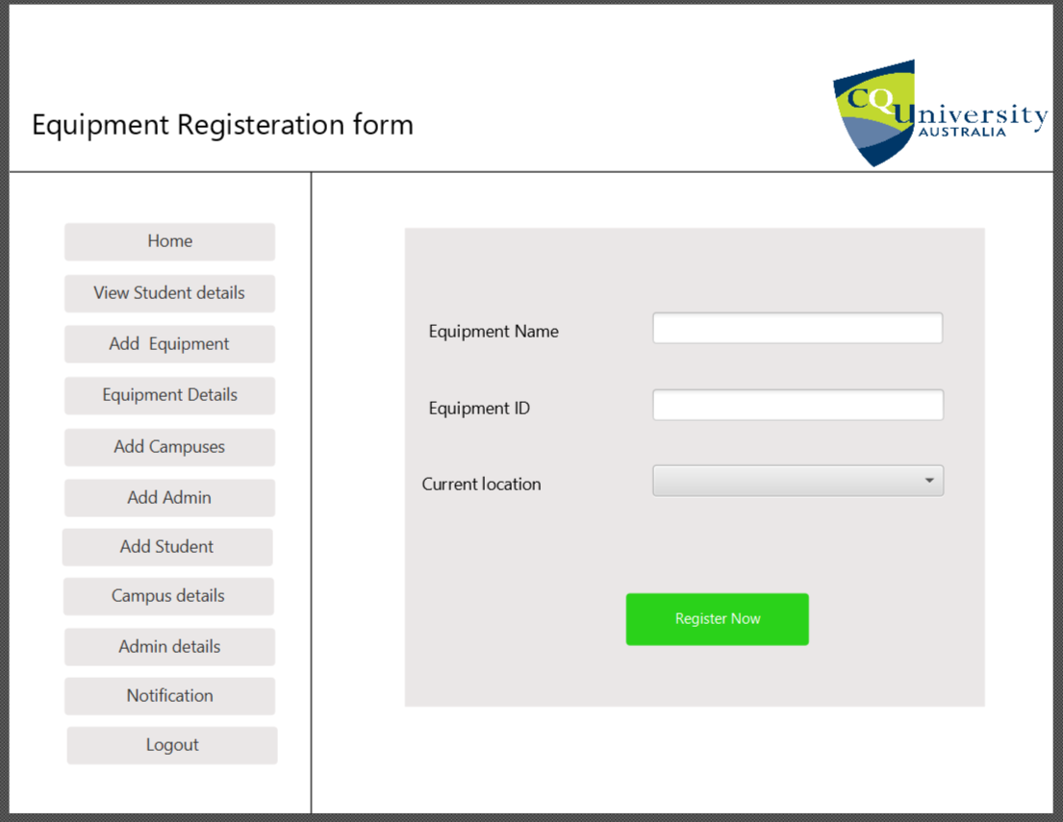
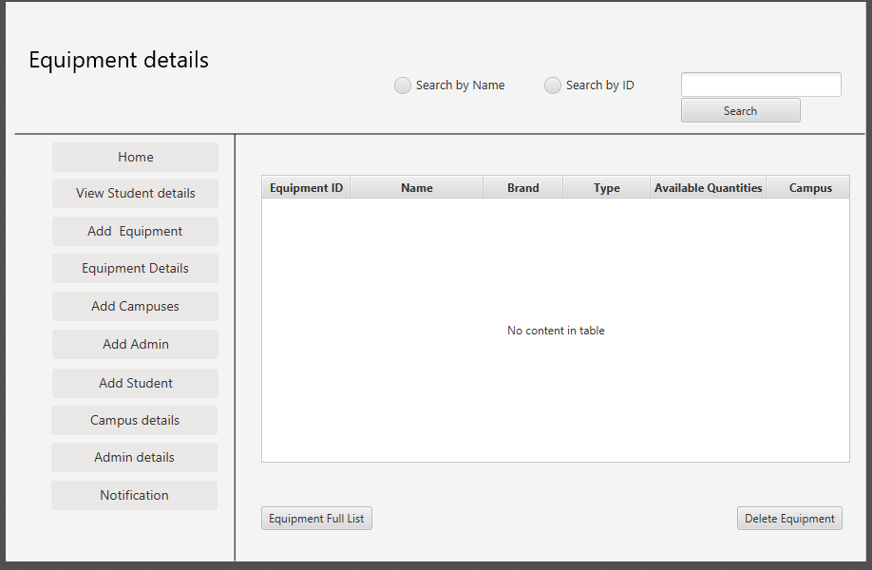
Add, Delete, view equipment details

Slide 32
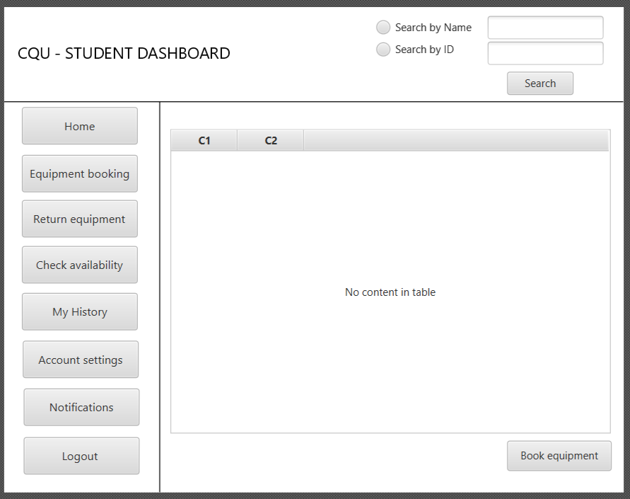
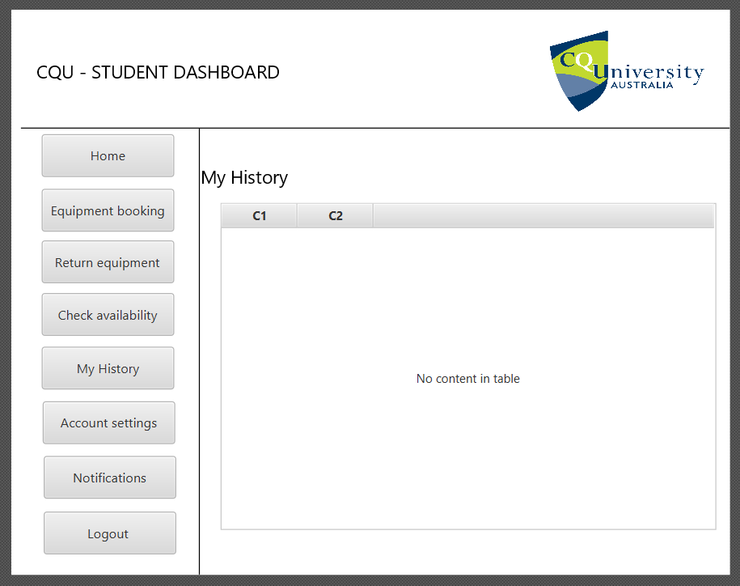
Equipment booking and view history

Slide 33
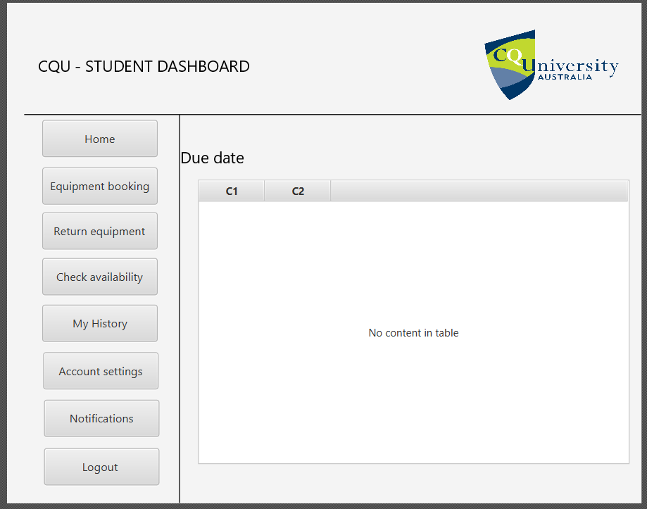
STUDENT DUE DATE

Slide 34
Product demo & user implementation

Slide 35
REFERENCES
ALTVATER, A. (2017). What is N-Tier Architecture? Examples, Tutorials & More. [online] Stackify. Available at: https://stackify.com/n-tier-architecture/.
Baqais, A.A.B. and Alshayeb, M. (2018). Sequence diagram refactoring using single and hybridized algorithms. PLOS ONE, 13(8), p.e0202629.
Fowler, M. (2019). Software Architecture Guide. [online] https://martinfowler.com/architecture/. Available at: https://martinfowler.com/architecture/.
Sinhal, A. (2017). MVC, MVP and MVVM Design Pattern. [online] Medium. Available at: https://medium.com/@ankit.sinhal/mvc-mvp-and-mvvm-design-pattern-6e169567bbad.
slidetodoc.com. (n.d.). Web Application Architecture multitier 2 tier 3 tier. [online] Available at: https://slidetodoc.com/web-application-architecture-multitier-2-tier-3-tier/ [Accessed 7 Aug. 2021].
Watt, A. (2014). Chapter 13 Database Development Process – Database Design – 2nd Edition. [online] Opentextbc.ca. Available at: https://opentextbc.ca/dbdesign01/chapter/chapter-13-database-development-process/.
Francino, Y. (2019). What is user story? - Definition from WhatIs.com. [online] SearchSoftwareQuality. Available at: https://searchsoftwarequality.techtarget.com/definition/user-story.
Gracia, T. (2019). What is a risk management plan? [online] Reciprocity. Available at: https://reciprocity.com/resources/what-is-a-risk-management-plan/.
Grant, M. (2021). Understanding Gantt Charts. [online] Investopedia. Available at: https://www.investopedia.com/terms/g/gantt-chart.asp.
Rehkoph, M. (n.d.). User Stories with Examples and Template. https://www.atlassian.com/agile/project-management/user-stories.

Slide 36
REFERENCES
Spacey, J. 2017. 7 Types of Feasibility Analysis. [Online]. [4 September 2021]. Available from: https://simplicable.com/new/feasibility-analysis
Richard daniels, R. 2021. What is Feasibility Study? 10 Types of Feasibility Study Explained. [Online]. [4 September 2021]. Available from: https://www.businessstudynotes.com/finance/project-management/types-feasibility-study/
Bridges, J. (2019). How to Conduct a Feasibility Study - ProjectManager.com. [online] ProjectManager.com. Available at: https://www.projectmanager.com/training/how-to-conduct-a-feasibility-study.
Brandenburg, L. (2018). How to Write a Use Case. [online] Bridging-the-gap.com. Available at: https://www.bridging-the-gap.com/what-is-a-use-case/.

Slide 37
THANK YOU

